Slide 1
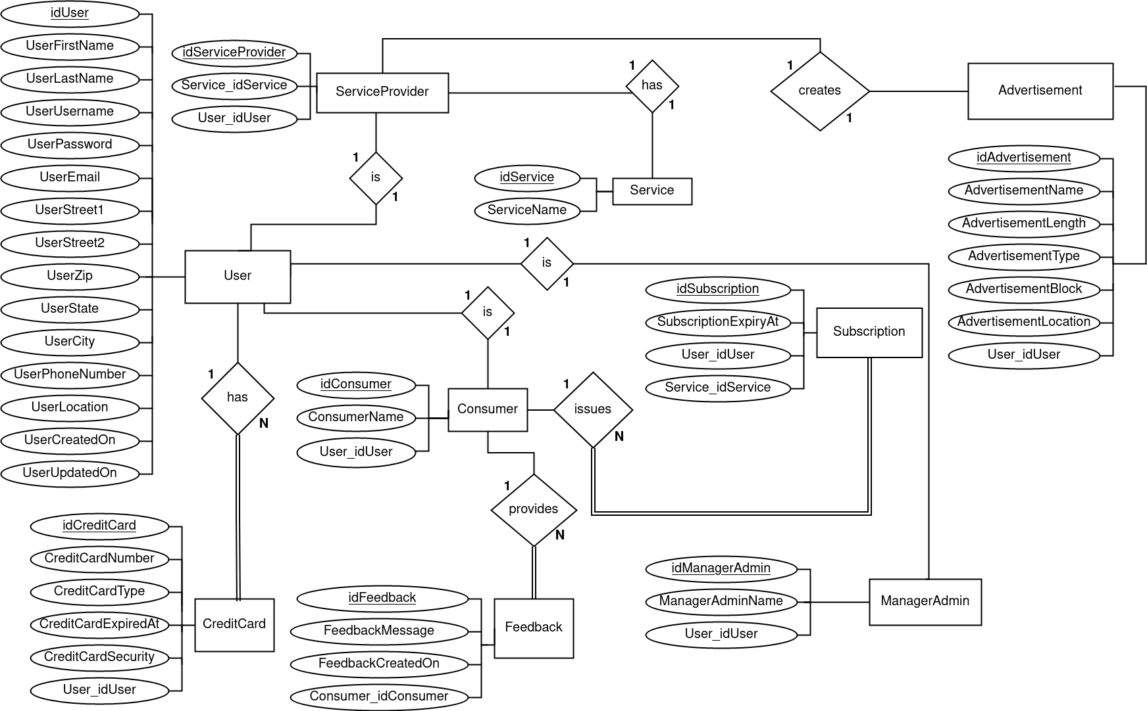
Servicegenerale’s
Conceptual
Entity-Relational
Diagram
10/4/21

Slide 2
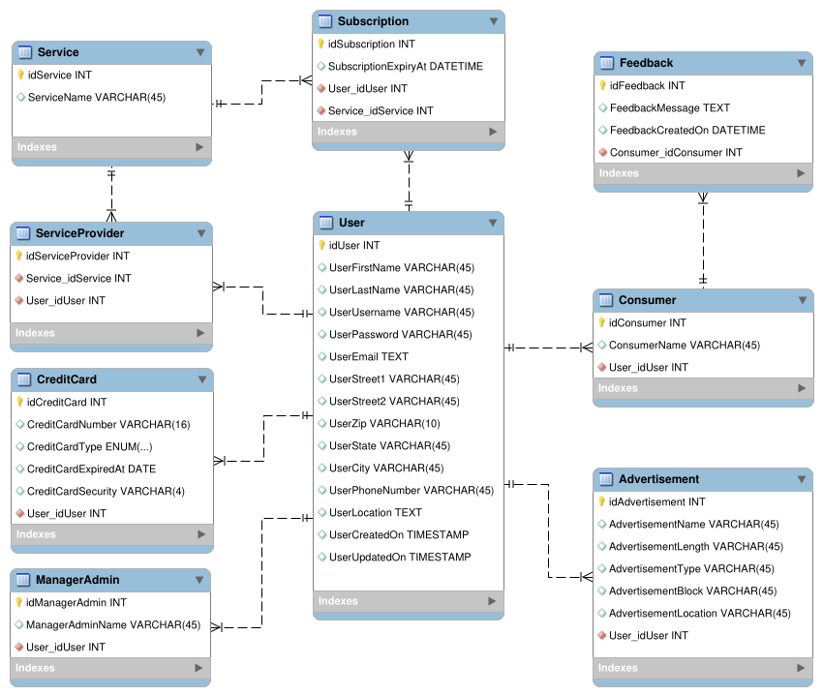
Servicegenerale’s
Logical
Entity-Relational
Diagram
10/4/21

